Slide 1
VACCINES & IMMUNIZATION (K.E.P.I) KRCHN MARCH 2018
BY
CHIKICHIK THOMAS

Slide 2
OBJECTIVES
By the end of the lesson ,the learner should be able to:
Demonstrate understanding of immunization systems and operations.
Explain immunization policies and cold chain activities

Slide 3
DEFINITIONS
KEPI:
Kenya Expanded Programme On Immunization
VACCINES:
A vaccine is made of an organism or a toxin which is either killed or attenuated.
They are substances prepared from micro-organisms (germs or viruses), which are live vaccines (weakened) or killed vaccines. When vaccines are given to someone, he/she develops immunity to particular diseases

Slide 4
IMMUNIZATIN:
Immunization is the process of introducing weakened or killed germs (vaccines) into the body, which increase body immunity to protect one from a particular disease.
its introduction of a vaccine into a person’s body to protect him or her against a particular disease
ATTENUATED:
Its When a vaccine is introduced into one’s body, the immune system is stimulated to produce antibodies that protect against future infections or severe disease

Slide 5
IMMUNITY:
Its the ability of the body to fight against certain disease organisms.
IMMUNE- COMPLEX:
Its also known as antigen-antibody complex, occurs from the bonding of an antibody to an antigen. immune complex molecules help in fighting diseases.
ANTIBODY-
its a protein produced by the body’s immune system when it detects harmful substances, called antigens. examples of antigens include micro-organisims (such as bacteria, fungi, parasites, and viruses).
ANTIGEN-
Its any substance that causes your immune system to produce antibodies against it. An antigen maybe a foreign sunstance from the environmentsuch as chemicals,bacteria,viruses,or pollen.

Slide 6
Vaccine Vial Monitor:
The VVM is a heat-sensitive label attached to vaccine vials which gradually and irreversibly changes color, from light to dark, as the vaccine is exposed to heat.
FREEZE WATCH INDICATOR:
Its a tool that tells you when the vaccine has been exposed to freezing temperatures. It is useful in detecting vaccines such as DPT, TT, HEP B that should not be frozen
Unit of Vaccines and Immunization services:
This is the unit within the Ministry of Health responsible for the provision and coordination of vaccination services in Kenya.

Slide 7
Cold-chain:
It s a system of ensuring that vaccines are maintained at the required low temperatures from the point of production until it reaches the consumer. ( +2-+8)
TARGET POPULATION”.
The number of children/pregnant women that need immunization in a catchments area
AEFI:
This is a reaction that occurs in a client/patient following vaccination that is considered to be related to the vaccine until proved otherwise.
CATCHMENTS AREA:
is a term that refers to the geographical region and the population within the region, that a health facility is mandated to serve.

Slide 8
AIMS OF EPI
1. Immunisation of at least 95% of all children fully before the age of 1 year
2. Eradication of poliomyelitis
3. Eradication of Neonatal tetanus
4. Control of measles.

Slide 9
TYPES OF IMMUNIZATION
1. Active immunisation
2. Passive immunisation
3. Natural immunisation
3. Artificially induced immunisation

Slide 10
1. ACTIVE IMMUNIZATION
Its when a person gets an infection and develops their own antibodies.
It also happens when a vaccine against a disease is given to someone,
These are called live attenuated vaccines.
Other vaccines are made out of killed bacteria ( vaccines)
yet others are modified poisons or toxins that bacteria produce (toxoids)

Slide 11
2. PASSIVE IMMUNIZATION
It is taking antibodies and give them to another person and because the person receiving these antibodies is not making them
Eg: it occurs every time a baby develops in the uterus of the mother as the mother’s antibodies pass into the baby’s blood and provide them with ready made antibodies against these diseases for a short time after birth.
advantage
-the individual who has this type of immunisation gets immediate assistance in fighting against an infection like snake bites or tetanus infection.
disadvantage,
- since they are not their own,
-there is no antigen stimulating the body to produce more,
-thus antibodies are gone in few weeks or months and the protection is lost.

Slide 12
3. NATURAL IMMUNIZATION
Immunity that occurs without vaccines or assistance of a health worker.
When organisms invade the body, the white blood cells called lymphocytes identify the organisms or products referred to as the antigen. The body then produces antibodies to fight the antigens. This is referred to as natural immunity.

Slide 13
4. ARTIFICIALLY INDUCED IMMUNISATION
Artificial Immunisation occurs any time that a medical worker immunises a person either by giving them a vaccine (antigen), or by passively immunising them with antibodies.
This is the type of immunity given through vaccine administration.

Slide 14
5. HARD IMMUNITY
This develops when a high proportion of the community, 80% or more are immunized
A case whereby a high % ( 80%) of people are immune to an infection either coz they have had an infection or been successfully vaccinated against it .
The high number of immune people acts as an umbrella protecting those who are still not yet immunized .

Slide 15
ROLE OFF A NURSE IN IMMUNIZATION
. Creating awareness of immunization in the community
2. Setting of immunization session both at the static clinic & the outreach clinic
3. Giving immunizations
4. Maintenance of cold chain
5. Record keeping
6. Teaching mothers on breastfeeding & immunization health education..

Slide 16
IMMUNIUZABLE DISEASES
to include:
diphtheria,
whooping cough,
tuberculosis,
hep B,
haemophilus influenzae type b,
pneumonia, diarrhea, , meningococcal meningitis etc.)
Measles

Slide 17
General norms and guiding principles for programme implementation
Community participation and social mobilization
Integrated approach- immunization services should be provided as an integral part of national family health programmes
Accessibility and equity
Provided to all target populations irrespective of ethnicity, gender or political and religious affiliation.
Quality of services and safety consideration
coordination and leadership
Regulatory issues relating to immunization
Most countries in the African region do not manufacture vaccines hence:

Slide 18
IMMUNIZATION SERVICE DELIVERY STRATEGIES AND INNOVATIVE APPROACHES
1. Immunization at static health facilities (fixed strategy)
2. Immunization delivery through outreach services
3. Immunization campaigns or supplementary immunization activities

Slide 19
SUPPLEMENTARY IMMUNIZATION
NIDs- designed to immunize all eligible children.
SNIDs- where a specific area is to be targeted, often for border districts with higher risk of polio transmission.
Mopping up –specifically a house-to-house SNID in a focal area where polio transmission is thought to be occurring
Short –interval additional dose (SIAD) – an intensified approach to deliver two successive doses of vaccines within a period of a few days (usually less than 2 weeks)

Slide 20
SUPPLEMENTARY IMMUNUIZATION FOR MEASLES ELIMINATION
Catch up campaign- one dose for all children between 9 months to 14 years is given , regardless of vaccination or disease history.
Follow- up- campaign –one dose of measles vaccine to children born since the catch –up campaign
Mopping up- where poor coverage was achieved in the catch-up or follow-up campaign, or when epidemiology evidence suggests measles transmission is focalized.
Periodic intensification of routine immunization (PIRI)- reinforces routine immunization and uses a second opportunity to immunize susceptible persons remaining in the population and those never vaccinated.

Slide 21
Vaccines Number of doses
BCG 1
Polio 4
Pentavalent 3
PCV 3
Rota 2
Measles 2
Yellow fever 1
Tetanus Toxoid for women of child bearing age (15-49 years) 5

Slide 22
IMMUNIZATION SCHEDULE
Age ANTIGEN
At birth BCG and Birth OPV
6 weeks DPT/HepB/Hib 1 and OPV 1
8 weeks ROTA 1
10 weeks DPT/HepB/Hib2 and OPV2,
14 weeks DPT/HepB/Hib 3 and OPV 3
4 months ROTA 2
6 months VIT A , Rota 3
9 months Measles
9 months Yellow Fever (in the four endemic districts of Baringo, Koibatek,Keiyo and Marakwet).
18 months 2 nd measles

Slide 23
ESSENTIAL ELEMENT FOR MAINTAINING VACCINES POTENCY
1. Personnel to manage vaccine distribution
2. Equipment for vaccine storage & transport
3. Maintenance of equipment
4. Monitoring
NB/The role of the cold chain is to maintain the potency of vaccines.

Slide 24
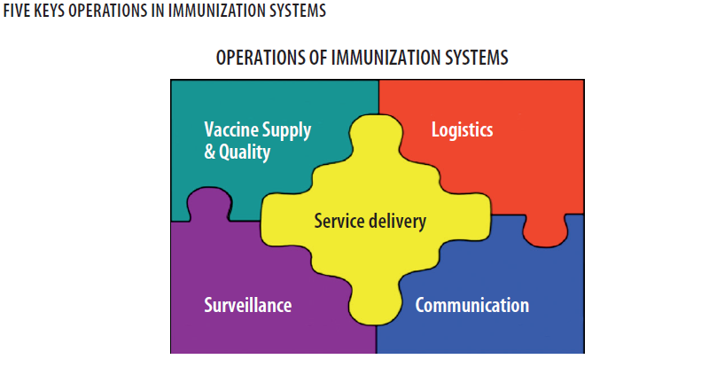

Slide 25
IMMUNIZATION OPERATIONS KEY COMPONENT
Service delivery- covers the strategies and activities to ensure provision of immunization services and target population.
Logistics- includes delivery of vaccines and other equipment to the place of use, provision to transport, management of cold chain and disposal of immunization waste.
Vaccine supply and quality- comprises forecasting vaccine needs procuring vaccine, monitoring vaccine quality, utilization and vaccine safety.
Disease surveillance- monitoring of disease incidence, laboratory testing, record keeping, reporting ,case and outbreak investigations and response.
Advocacy and communications- comprises social mobilization, advocacy, community education on immunization and programme promotion.

Slide 26
VACCINES

Slide 27
its a biological preparation that improves immunity to a particular disease.
The term vaccine derives from Edward Jenner's1796 use of the term cow pox (Latin variolæ vaccinæ, and vacca=cow), which, when administered to humans, provided them protection against smallpox.
A vaccine typically contains an agent that resembles a disease-causing microorganism, and is often made from weakened (inactivated) or killed (dead) forms of the microbe or its toxins.

Slide 28
The agent stimulates the body's immune system to recognize the agent as foreign, destroy it, and "remember“
Recently introduced Vaccines in the Kenyan routine immunization for children under one year is the PCV-10 which guards against Pneumococcal infections such as pneumonia, meningitis and Otitis media.

Slide 29
VACCINES DEVELOPMENT
Scientists take several approaches to develop vaccines against a microbe. The choice is based on fundamental information about the microbe, such as:
How it infects cells
How the immune system responds to it,
As well as practical considerations, such as regions of the world where the vaccine would be used.

Slide 30
TYPES OF VACCINES
.1. Mono-vaccines and combination vaccines
2. Live and killed vaccines
3. Bacterial and viral vaccines
4. Sub-unit vaccines (toxoid, polysaccharides, etc)
5. Liquid vaccines and lyophilized (dried vaccines)

Slide 31
EXAMPLES OF VACCINES
1. Mono-vaccines measles
2. Combined or polyvalent DPT
3. Bacterial vaccine – vaccines against cholera pertussis
4. viral vaccines – OPV and vaccines against measles , mumps rubella ,yellow fever
5. Liquid vaccines: DPT, Polio vaccines
6. Lyophilized (dry) vaccines: BCG, Measles

Slide 32
CHARACTERISTICS OF IDEAL VACCINES
1. Immunogenic provoking a good immune response
2. Providing long lasting immunity
3. Safe with no or very rare AEFIs
4. Stable in field conditions and can be stored reasonably long without or with a very minimum cold chain requirements
5. Combined ,with several antigens producing immunity against a number of diseases
6. Administered with a single dose ,preferably by non-injectable routes (oral or through inhalation)
7. With affordable cost and accessible to all.

Slide 33
1. BCG (Bacillus Calmette-Guerin) Vaccine
This is a live attenuated bacterial vaccine against tuberculosis that is usually freeze-dried.
It is named after two French scientists, Dr Calmette and Dr Guerin
The vaccine is given to babies soon after birth,
It should be stored in a regular refrigerator (not in the freezing compartment)
it can remain potent for up to two years.
Once it has been diluted, the vaccine loses its potency very quickly and must be discarded after six hours (6HOURS)

Slide 34
BCG vaccine is given in a single dose at birth or first contact.
The vaccine is very sensitive to light and loses much of its potency when exposed to light.
It is given by injecting the child intradermally (in the skin) at the left upper arm.
The amount of 0.05mls is recommended for children up to eleven months of age,
Dose of 0.1 ml for children after eleven months of age.

Slide 35
Stapes to fallow when administering BCG vaccine
Clean the skin with dry cotton wool soaked in clean water and let it dry.
Hold the middle of the child's upper right arm firmly with your left hand.
Hold the syringe by the barrel with the millilitre scale upward and the needle pointing in the direction of the child's shoulder.
Do not touch the plunger.

Slide 36
Point the needle against the skin, barrel turned up, about 3cm above your thumb.
Gently insert its tip into the upper layer of the skin.
Make sure that the needle is in the skin (intradermal) and not under the skin,
If you bend the needle, replace it with another sterile one.
Holding the barrel with your index and middle finger, put your thumb on the plunger.

Slide 37
Holding the syringe flat, that is, parallel to the surface of the skin,
inject the vaccine intradermally.
For children above 11 months of age, inject 0.1 ml.
For children under 11 months of age, inject 0.05 ml.
If the vaccine is injected correctly into the skin, a wheal, with the surface pitted like an orange peel, will appear at the injection site. An indication that the vaccine has been injected incorrectly is that the plunger will move much more easily when the needle is injected under the skin than when it is injected in the skin.

Slide 38
If there is no local reaction, re-immunise the child.
Change the syringe and needle after each antigen (vaccine) and each child.
Fill in the Immunization Tally Sheet in BCG section.
Administer the next antigen.

Slide 39
GIVE THE MOTHER HEALTH INFORMATION ABOUT BCG
In 5 to 7 days a small sore will appear at the place where the injection was given.
The sore might ooze a bit and will last for 6 to 8 weeks.
Keep the baby's arm clean with soap and water.
Do not put medicine or dressing on the sore.
The sore will not hurt, and it will heal by itself.

Slide 40
PREPARING FOR BCG & MEASLES VACCINES
Use the diluent provided for each vaccine. Diluent should be cold: +4 - +8 degrees centigrade.
Use different 5ml syringes for mixing measles and BCG vaccines.
Draw up the full, required amount of the diluent provided as per instruction on the vial.
Inject diluent into vial.
Draw and expel mixture back into the bottle three times or until the vaccine is mixed.

Slide 41
Do not shake the vial.
Measles and BCG vials should be placed on a frozen ice pack or use the sponge in the vaccine carrier for maintaining the correct temperature.
Draw 0.5ml of measles vaccine (recommended dosage).
Draw 0.05ml of BCG vaccine for babies up to 11 months old, and 0.1ml for babies above 11 months (recommended dosage)

Slide 42
2. ORAL POLIO VACCINE (OPV)
The oral polio vaccine contains live attenuated virus from all three types of polio.
TYPES OF POLIO VACCINE
Monovalent polio vaccine -against only one strain of polio virus(either type 1 or type 2 poliovirus)
Bivalent polio vaccine, a new double strain polio vaccine, is more effective than triple and single strain vaccines and could play a major role in polio eradication
Trivalent-a polio vaccine :that targets all the three subtypes of poliovirus.
Inactivated oral polio vaccine

Slide 43
The Sabin type is given orally (by mouth) in Kenya. Some countries use another type, called Salk vaccine, which is given by injection.
Oral polio vaccine is given four times beginning at birth
Two drops in the mouth are recommended for each dose.
It should be noted that booster doses are sometimes given to all children below five years of age in the entire country regardless of immunisation status.
This is done during National Immunisation Days (NIDs), whose primary objective is to eradicate poliomyelitis.

Slide 44
POLIO IMMUNIZATION SCHEDULE
Polio 0: Birth or first contact
Polio 1: 6 weeks
Polio 2: 10 weeks
Polio 3: 14 weeks

Slide 45
Preparing Polio Vaccine
To prepare this vaccine you should do the following.
If a dropper is separate, attach it securely to the vial (bottle).
Keep polio vaccine shaded from sunlight during the immunisation session.
Place the vial on a frozen ice pack or place it in the hole of the sponge placed at the mouth of a vaccine carrier, which is provided for this purpose to maintain the temperature.

Slide 46
3. PENTAVALENT
This is the newly introduced combination of immunisation against diphtheria, pertussis (whooping cough), tetanus, hepatitis B and influenza.
The dose is 0.5ml.
The first dose is given six weeks after birth, the 2nd at ten weeks after birth and 3rd at the age of 14 weeks

Slide 47
Pentavalent has five vaccines which include diphtheria, pertussis, tetanus, and hepatitis B and Haemophilus influenza type B.
The Pentavalent vaccine is given by injecting the child intramuscularly (in the muscle) at the left upper thigh.
It is given three times, beginning at 6 weeks), at 10 weeks and 14 weeks respectively.
A dose of 0.5 ml is recommended at each time it is given.

Slide 48
HEALTH TALK TO THE MOTHER ON DPT/PENTAVALENT
1. DPT may cause some tenderness at the place the injection was given.
2. This tenderness will go away after a few days.
3. DPT may cause fever but the fever will subside in 24 hours.
4. Teach the mother how to care for a child with fever.
5. Fill in the Immunisation Tally Sheet appropriately.

Slide 49
Preparing pentavalent, TT and PCV vaccines:
These vaccines come in liquid form. You will not need to dissolve or mix them.
Remove metal top from the vial
Draw 0.5ml into the sterile syringe
Remove bubbles
Keep the vaccines shaded from light.

Slide 50
Tetanus Toxoid Vaccination Schedule: Every woman of child bearing age (15-45years), including pregnant women, should get 5 doses of Tetanus Toxoid (TT) vaccine.
First dose (TT1): At first contact or as early as possible during pregnancy.
Second dose (TT2): At least 4 weeks after first dose.
Third dose (TT3): At least 6 months after second dose.
Fourth dose (TT4): At least 1 year after third dose.
Fifth dose (TT5): At least 1 year after fourth dose.

Slide 51
4. MEASLES VACCINES
Its a live attenuated freeze-dried vaccine given at nine months old and a second dose at 18 months.
It is administered by intramuscular injection (on the right deltoid.)
in a dose of 0.5ml.
An oral vitamin A tablet, 200,000 i.u., is routinely given with the measles vaccine.

Slide 52
Failure of Measles Vaccination
It has been noted that some children still suffer from measles in spite of the fact that they were vaccinated.
The possible causes of this may be:
1. Impotent measles vaccine may have been used
2. The vaccine may have expired or may have been kept at the wrong temperature
3. The child may have been vaccinated while still too young thus having their mother’s antibodies still in their blood
4. The parents may have misreported some rashes and pyrexia, which appear similar to measles yet it is not

Slide 53
CONTRA-INDICATION OF MEASLES
In severe malnutrition, it is recommended that the vaccination be delayed until the child is well nourished. In mild or moderate malnutrition, it should still be administered.

Slide 54
ROTA VACCINE
Rotavirus is a virus that is acquired via fecal-oral route and causes severe diarrhea mostly in babies and young children.
It is often accompanied by vomiting and fever.
Rotavirus is non-enveloped, composed of a segmented, double-stranded RNA genome

Slide 55
It is a pentavalent human-bovine reassortant vaccine that is given orally
It was previously a reassortant rhesus-human rotavirus vaccine tetravalent (RRV-TV) but was withdrawn from the market in July 1999 by the CDC, after approximately 1 million children had been immunized with the vaccine and there was an increase in the number of children who developed intussusception

Slide 56
DOSES
Children should get 3 doses of rotavirus vaccine.
They are recommended at these ages:
First Dose: 2 months of age
Second Dose: 4 months of age
Third Dose: 6 months of age
The vaccine has not been studied when started among children outside that age range.
Rotavirus vaccine may be given at the same time as other childhood vaccines.
Children who get the vaccine may be fed normally afterward

Slide 57
EFFICACY
Its efficacy was evaluated in two large clinical trials. After three doses the vaccine was 74% effective against rotavirus gastroenteritis of any severity and 98% effective against severe rotavirus gastroenteritis.
In another study, the vaccine reduced the incidence of office visits by 86%, emergency room visits by 94% and hospitalizations for rotavirus gastroenteritis by 96%.

Slide 58
SIDE EFFECT
Children are slightly (1-3%) more likely to have mild, temporary diarrhea or vomiting within 7 days after getting a dose of rotavirus vaccine than children who have not gotten the vaccine.
No moderate or severe reactions have been associated with this vaccine.

Slide 59
CONTRA-INDICATIONS
1. A child who has had a life-threatening allergic reaction to a previous dose or a component of the vaccine should not get another dose.
2. mmunocompromised patients:
HIV/AIDS, or any other disease that affects the immune system
Treatment with drugs such as long-term steroids
Cancer, or cancer treatment with x-rays or drugs
3. There is no safety information related to the administration of vaccine to infants with gastroenteritis. It is recommended that rotavirus vaccine not be administered to infants with acute, moderate-to-severe gastroenteritis
4. A child who has recently had a blood transfusion or received any otherblood product (such as immune globulin).

Slide 60
OTHER VACCINES
1. Rabies vaccine
Rabies vaccine is given to people at high risk t protect them if they are exposed. The vaccine is made from killed rabies virus and is administered intramuscularly.
Pre-exposure vaccination is in three doses:
Dose 1: as appropriate
Dose 2: 7 days after 1st dose
Dose 3: 21 or 28 days after 1st dose
Vaccination after exposure to the virus is given in 4 doses; day 0, 3, 7 and 14

Slide 61
2.Typhoid vaccine
There are two types of the typhoid vaccine. One is an inactivated (killed) vaccine gotten as an injection
The live attenuated vaccine which is taken orally.
given as a single dose intramuscularly.
A booster is given every 2-3 years especially to people who remain at risk.

Slide 62
3.Yellow fever vaccine
Yellow fever vaccine is a live attenuated virus.
It is given as a single dose, For people who remain at risk,
a booster dose is recommended every ten years.
Can be given to persons from 9 months to 59 years who are travelling to or living in an area where the risk of yellow fever is known to exist.

Slide 63
Key messages to remember
Never take two vials of the same vaccine out of the vaccine carrier at the same time.
Do not mix vaccines until mothers and children are present.
Mix one vial of a particular vaccine at a time
Keep opened vials of polio, measles, and BCG vaccines on a frozen ice pack or use the sponge in the vaccine carrier. Their temperature must be carefully maintained.
Do not keep vials of pentavalent and TT vaccines directly on the frozen ice pack.
Open the vaccine carrier only when necessary.

Slide 64
7. Use one sterile syringe and needle per vaccine per child or mother.
8. Avoid holding loaded syringes in your hands for long so as not to expose vaccine to heat or direct sunlight.
9. Inform each parent what type of vaccine you are giving the child, the possible reactions to it, what to do about the reactions, and when to bring the child back for more immunisation.
10. Listen to parents and encourage questions.
11. Remove any child’s clothes that are in your way when vaccinating

Slide 65
During immunisation you should:
1. Ask the mother to hold the child firmly to restrict his/her movement during immunisation.
2. Administer the vaccine.
3. Give specific health information about each vaccine

Slide 66
Target group for immunization
1. Children (0-5 years)
2. Pregnant women
3. School children
4. Travellers
5. Food handlers
6. Animal handlers
7. Women of child bearing age

Slide 67
Problems Encountered in the Program.
1. Vaccine wastage
2. Progress Evaluation and Reporting
3. Vaccine Stock-outs
4. Financial Constraints

Slide 68
Specific health advice during immunisation
It is important that parents or guardians are given health advice
The name of the vaccine you are giving the child.
ii. The name of the disease the vaccine prevents.
iii. The possible side effects and what to do about them..
iv. The return date for additional vaccines.

Slide 69
STRATEGIES FOR ERADICATION OF CHILDHOOD IMMUNISABLE DISEASES.
1. Strengthening of routine immunization activities to achieve and maintain the highest levels of coverage for all antigens.
2. Mass vaccination of children within the shortest possible time through National Immunization Days (NIDS)
3. Strengthening EPI target disease surveillance system such that every case of any of these diseases is reported, fully investigated and contacts of positive cases protected.
4. Conducting "mopping-up" immunisation when the diseases are reduced to focal transmission.

Slide 70
ADVERSE EVENTS FOLLOWING IMMUNISATION (AEFI)

Slide 71
INTRODUCTION
The goal of immunization in Kenya is to protect the public from vaccine preventable diseases.
Modern vaccines are safe; although after immunization, some people may experience reactions;
ranging from mild local reactions to life-threatening illnesses.

Slide 72
Broad objective
To assist health workers improve their knowledge, skills and knowledge towards AEFI.
Specific Objectives:
1. Define AEFI
2. How to identify AEFI
3. State the possible causes of AEFIs.
4. To detect and report AEFI
5. State the steps involved in investigating adverse events.
6. Outline the steps taken in managing AEFI cases.
7. Describe how to prevent cases of AEFI.

Slide 73
DEFINITION AEFI
An adverse event following immunization is a medical incident that that occurs during or after an immunization and is believed to be caused by immunization.

Slide 74
CAUSES
1. Programmatic errors: Usually they are person based i.e. an error in handling, reconstitution or administration of the vaccine.
2. Nature of the vaccine (vaccine properties) or individual response to the vaccine itself.
3. Coincidental, is an event that has no causal association between the immunization and the medical condition of the child or woman.
4. Unknown cause. The cause of the event cannot be determined.

Slide 75
Common minor vaccines reactions
Local reaction (pain, swelling and/or redness), fever and systemic symptoms (e.g. vomiting, diarrhea, malaise) can result as a part of the immune response.
Local reactions and fever should be anticipated in only 10% of the vaccine recipients, except in the case of whole cell DPT which produces fever in nearly half of those vaccinated.
Fever and minor local and systemic reactions usually occur within a day or two of immunization (except for those produced by measles/MMR vaccine which occurs 6 to 12 days after immunization) and only last for few days.
Fever and minor local reactions can usually be treated symptomatically with paracetamol.

Slide 76
Health workers should detect and report the following:
1. Anaphylactic shock
2. Injection site abscesses.
3. Cases of BCG lymphadenitis
4. Cases requiring hospitalizations that are thought by health workers, or the public, to be related immunization
5. Unusual medical incidents that are thought by health workers, or the public, to be related to immunization.
6. Deaths that are thought by health workers, or the public, to be related to immunization.
In routine surveillance the health worker is expected to submit a report of any AEFIs identified to the supervisors at the district level.

Slide 77
How to identify AEFI
The cardinal signs of anaphylaxis are:
• Itchy, urticarial rash (in over 90% of cases)
• Progressive, painless swelling (angioedema) about the face and the mouth, which may be preceded by itchiness, tearing, nasal congestion or facial flushing
• Respiratory symptoms, including sneezing, coughing, wheezing, and laboured breathing; upper way swelling (indicated by hoarseness and/of difficulty swallowing) possibly causing airway obstruction
• Hypotension, which generally develops later in the illness and can progress to cause shock and collapse.
It must be differentiated from fainting, anxiety and breath holding which are more common and benign reactions.

Slide 78
Who does AEFI data Analyses?
• The health worker who detects the event and conducts the case investigation can carry out AEFI data analysis at initial stage.
• Epidemiologist
• Clinician
• Laboratory technician or
• Disease Surveillance coordinator.

Slide 79
Contraindications
• Before immunization, ascertain client history for allergies and previous adverse reactions to vaccines.
In the case of a possible serious allergy, check with the appropriate supervisor before giving vaccine.
• This procedure will minimize the occurrence of anaphylaxis but will not remove the risk altogether.
• Low-grade fever, mild respiratory infections and other minor illnesses should not be considered as contraindications to immunization. Diarrhoea should not be considered a contraindication to OPV. It is particularly important to immunize children suffering from malnutrition.

Slide 80
PROGRAMME ERROR
All the effort so far is wasted if action is not taken to correct the error. If an AEFI was caused by programme error, such as improper handling of vaccines or faulty immunization technique, the actions to be taken will probably include one or more of the following:
• Logistics: Improving logistics will be the appropriate response if investigations indicate lack of supplies or equipment or failure of the cold chain.
• Training: Trainings often used to solve operational problems:• Supervision: Non-serious AEFIs (e.g. abscesses) reported to the health facility should be able to alert the health worker to seek for the cause for immediate corrective action.
• Communication: Health workers should inform parents and the community about AEFIs,

Slide 81
VACCINES MANAGEMENT

Slide 82
The effectiveness and success of KEPI in reducing the burden of immunization preventable diseases depends on the quality of vaccines at the point of use, which in turns reflects the usefulness of the vaccine management system.
In order to reduce mortality, morbidity and disability, immunization session must safely administer potent vaccines to susceptible children and women before they are exposed to immunization preventable diseases.

Slide 83
The immunization programme aims at resolving vaccine and management problems include:
1. Reduction of the incidences of overstocking or under stocking of vaccines
2. Ensuring proper accountability for all vaccines at all levels
3. Reduction of vaccine wastages

Slide 84
TARGET SETTING
Each Sub-county is expected to set targets for two population categories
• Children less than 1year
• Women of child bearing age

Slide 85
Next time

Slide 86
VACCINES FORECASTING
In order to accurately estimate the vaccines, reliable data must be collected from the health facilities to the districts. Having set the target number of children to be vaccinated in the new-year, each health facility should forecast the number of doses of vaccines required to reach all the target children and childbearing age women.

Slide 87
Advantages of obtaining accurate forecasting of vaccine needs
1. It leads to efficient management of vaccines and immunization sessions
2. It eliminates shortages or overstocking of vaccines
3. It improves vaccine use and reduction of wastages
4. It helps to monitor the progress of immunization in relation to target coverage

Slide 88
The three methods commonly used to estimate vaccine needs:
1. Target population
2. Previous consumption
3. Size of immunization sessions
All facilities are required to estimate vaccine needs using the target population method and if the Health facilities are sharing the same population, previous consumption method would be suitable.

Slide 89
1. Target Population Method
Target population is the number of children under one year and women of childbearing age (15- 49 years old).
To estimate vaccine needs on the basis of target population a number of parameter are necessary, which are:
a. Target population
b. Immunization schedule
c. Immunization coverage target
d. Wastage rate and wastage factor

Slide 90
Immunization coverage target
The national policy is to reach every child. The Immunization coverage target for each antigen is depends on the health facility and district micro plans and work plans respectively. These plans indicate the attainable percentage coverage at the end of current year.

Slide 91
Vaccine wastage rate and wastage factor
During immunization, the number of vaccine doses used is generally higher than the number of individuals immunized. The number of doses in excess represents “lost doses “or vaccine wastage.
These may include:
The remainder of doses discarded with vials after the immunization session
Doses given outside the target
Doses spoilt for one reason or the other e.g. VVM reached discard point, breakdown in the cold chain, frozen DTP+ HepB and TT or removed labels.
Doses from vials broken during transport and handling
Missing doses from vaccine stock ledgers etc
Number of unopened vaccines vials lost should be documented in the ledger books to facilitate

Slide 92
Calculations of wastage rate and factor.
Vaccine wastage can be explained into two ways:
1. Wastage rate
2. Wastage factor

Slide 93
1. Vaccine wastage rate
Vaccine wastage rate should be taken into account in the estimation of vaccine needs. Knowing the wastage rates helps to determine the wastage factor, which is one of the parameters used to estimate vaccine needs.
Vaccine wastage rates are not standard. Every County and health facility must calculate its monthly vaccine wastage rates of antigens and by the end of year know their vaccine wastages, which would be used for estimation of the vaccines.

Slide 94
Formula for Wastage rate (%)
wastage rate %: Doses used – doses administered x100
Doses used
Doses used include vaccines administered and wasted doses
Doses administered are doses which have been received by the targeted group.

Slide 95
Example on wastage rate
Kaibos health facility had 200 doses of BCG vaccine in the month of July 2017 and immunized 150 children under one year.
To calculate the vaccine wastage rate for Kaibos health facility using the formula is as follows:
200 – 150 X 100 = 25%
200

Slide 96
Wastage Factor
Vaccines Wastage Factor is a multiplier used to order vaccines to cater for the targeted population and wastage.
The total number of vaccines supplied within given period is referred to as 100% supply.

Slide 97
Formula for calculating wastage factor
100% supply = Wastage Factor
(100% supply – Wastage Rate)
Using Kaibos Health Facility example the wastage Factor is calculated as follows:
100 = 100 = 1.33
(100 - 25) 75
In other terms, for every dose of a given antigen in the immunization schedule, we must anticipate ,1.33 doses to take account of 25% wastage in the use of the vaccine.

Slide 98
Calculating vaccine needs for a district and health facility
Using the above parameter the total annual vaccine doses are estimated by use of the following
Formula:
Target Population x immun. schedule x Wastage factor = Total Annual doses
i.e T.p x immunization schedule x W.f = Total Annual doses

Slide 99
Note: Target coverage for the health facility level is 100% this is in line in reaching every child in the catchment area. Therefore the target coverage is 1
Example 1: (health facility to be formulated after target setting example to make it flow)
Kaibos health facility in kapenguria sub-county has a total population of 350,000 in 2017. The children under one year comprise 4% and women of childbearing age are 24% of the total population. The district vaccine manager was to forecast and order for all the routine vaccine. During the previous year the district immunized 10,000 children with BCG and had received 24,000 doses from the regional stores. The store had a balance of 4,000 doses of BCG at the end of the year 2004.

Slide 100
Using the Forecast Sheet (Annex xxx see table) the manager will forecast and order on after the calculation
Sequential calculations using the forecast sheet. See table
A. The target population is calculated as follows:
• Children under one year
4/100 x 350,000 = 14,000
• Women of childbearing age
24/100 x 350,000 = 84,000
B. Doses in immunization schedule for BCG is one dose
C. Wastage Factor for BCG from the example above of kaibos Health facility is 1.33
D. Total doses required for the district this year is calculated as follows:
Target population x immunization schedule x wastage factor = 14,000 x 1 x 1.33 =18,620

Slide 101
The data required for estimating vaccines needs on the basis of previous consumption are:
a. Number of children immunized previously
b. Wastage factor for the specific antigen
c. Immunization schedule for the antigen.

Slide 102
ORDERING VACCINES
Steps in ordering Vaccines
1. Defining vaccine supply period
2. Calculating quantities of vaccine for a supply period
3. Calculating minimum stock level
4. Calculating maximum stock level
5. Calculating total quantities of vaccine to be ordered

Slide 103
Advantages of ordering vaccines
a. Prevent vaccine stock outs and overstocking.
b. Prevent expiry of vaccine during their storage period.
c. Ensures that the other appropriate supplies are “bundled” e.i. Safety boxes, syringes and needles.

Slide 104
Calculating quantities of vaccine for a supply period
The needs for a specific storage or supply period can be calculated as follows:
Vaccines needs for the period = Annual vaccines needs X Supply period (in months)
Number of months in year
Using the formula:
Qperiod = (Qyear/12) x Psupply
Where,
Qperiod = Vaccines needs for the period
Qyear = Annual vaccines needs
Psupply = Supply period (in months)

Slide 105
Example: using Kasei Health Facility CHECK PGS 32/33 (greenbook)
14,000 x 1 x 1.33= 18,620 doses
County calculations = 3/12 x 18,620 = 4,655doses
Health facility calculations =1/12 x 18,620 = 1,552doses

Slide 106
Calculating minimum stock level
The “minimum stock” represents the minimum number of vaccine doses that should be in the refrigerator
on the arrival of the next supply consignment. The level of minimum stock is generally fixed at 25% of the total estimate of vaccines needs for a given supply period.
Using a formula
Minimum stock = Vaccines needs for the period X 25 %
mini =Qperiod x 25% (or 0.25)
Note: the minimum stock takes into account the possible delays in supply as well as unexpected increase in the population to be immunized (untargeted population, migration, etc.).

Slide 107
Calculating maximum stock level
The maximum stock is the maximum number of vaccine doses that should be found in the refrigerator after a supply.
Using the formula:
Minimum stock = Vaccines needs for the period + Minimum stock
maxi = Qperiod + Smini
Example
4,655 + 1,164 = 5,819 doses

Slide 108
Calculating total quantities of vaccine to be ordered
Once the order levels are determined, the vaccine quantities to be ordered are calculated on the basis of the balance in stock at hand and the maximum stock.
The order may be based either on specific supply period (quarterly for County and monthly for health facility) irrespective of the consumption.
A stock shortage may occur before the end of the period.
It is therefore recommended that an order be placed as soon as the stock of an antigen reaches the point where an order should be placed
.
General formula:
Quantity to order = Maximum stock – stock at hand
Qorder = Smaxi – Savailable

Slide 109
CONTROLLING VACCINE STOCKS
1. Receiving delivered vaccines and supplies
2. Storage, transport and handling of vaccines
3. Organizing vaccine distribution
4. Inventory of vaccine stocks

Slide 110
REFRIGERATORS

Slide 111
Health facility refrigerators may be powered by electricity, gas, kerosene, or solar energy.
Electric refrigerators are usually the least costly to run and the easiest to maintain,
but they must have a reliable electricity supply.
Where the electricity or fuel supply is not reliable, ice-lined refrigerators can maintain the appropriate temperature for 16 hours without power if they operate with power for at least eight hours a day.
But the use of ice-lined refrigerators may expose vaccines to the risk of freezing
Refrigerators have different capacities for storing vaccines and for freezing and storing ice-packs.

Slide 112
VACCINE REFRIGERATORS HAVE TWO COMPARTMENTS:
A main compartment (the refrigerator)
for storing vaccines and diluents, in which the temperature should be kept between +2ºC and +8ºC.
The thermostat is used to adjust the temperature.
A second compartment (the freezer)
for freezing ice-packs. If the refrigerator is working properly, this section will be between -5ºC and -15ºC.

Slide 113
TYPES OF REFRIGERATORS
1. Compression
2. Absorption

Slide 114
1. COMPRESSOR
Most electric and solar
It uses an electric motor compressor to circulate a cooling fluid called refrigerant .
The pump compresses the refrigerant from a gaseous state into a liguid state ,a process which gives off heat
The compression system circulates the refrigerant very quickly and thus a much greater cooling effect than the absorption system .
The temperature in the storage area is controlled by an automatic thermostat which the compressor motor on and off at the desired temp

Slide 115
2. ABSORPTION
These use heat produced by electricity or burning gas or kerosene to drive a cooling cycle under pressure produced by hydrogen
The heat causes ammonia and h2o to circulate in a sealed system of pipes .In the evaporator inside the refrigerator ,the ammonia fluid turns into gas ,absorbing heat from the inside air .as a gas ,it rises circulating to the outside of the refrigerator where it condenses into a liquid ,releasing the heat to the outside air.
NB less efficient than compression because of the slow circulation of the refrigerant but much more suitable where there is weak, unreliable electricity supply .

Slide 116
FRIDGES MODELS
COMPRESSION
RCW 42EG
ABSORPTION
Sibir S2323
RA 1300
VR 50 solar

Slide 117
PACKINGING
The vaccines are placed such that polio, measles ,BCG are in the coolest part of the refrigerator .Penta,TT,PCV10 should be in the middle
Ice pack & diluents at the bottom shelves.
The vaccines are arranged in trays of different colours .
The most sensitive to heat being polio.
no vaccines should be stored in the freezer compartment instead only the ice packs are stored there.
A sticker is posted on the front of the refrigerator to explain how to place them.

Slide 118
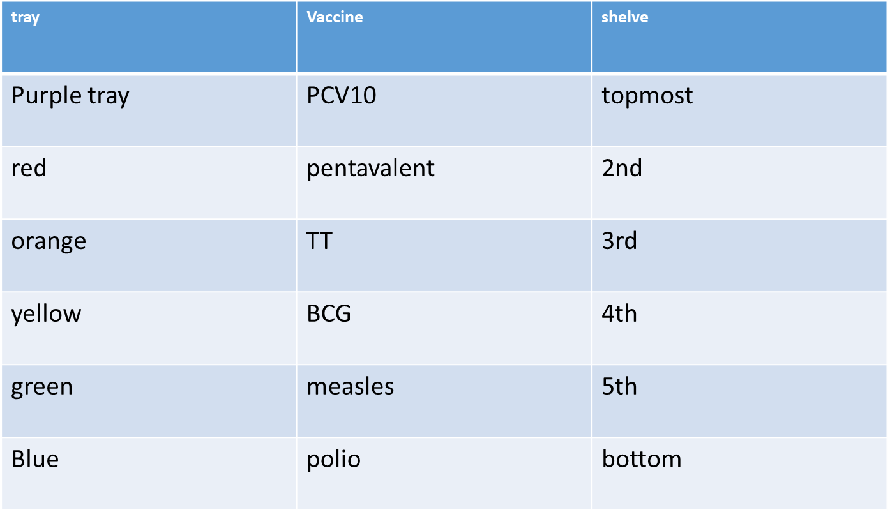
ARRANGEMENT OF VACCINES IN A REFRIGERATOR

Slide 119
HOW TO CARE FOR REFRIGERATOR
Do not operate on two sources of energy at the same time
Check temp BD
Check ice formation on the evaporator ,if the ice is thicker than 6mm to 10mm defrost the refrigerator .thick will make temp to rise
If using a burner check the flame it should be blue.

Slide 120
HOW TO KEEP VACCINES COLD IN THE REFRIGERATOR
Place vaccine in the correct compartment
Avoid unnecessary opening
Ensure maintenance of ideal temp
Defrost the refrigerator regularly
Pack with space in between
Avoid packing the vaccine in contact with the evaporator

Slide 121
1. Daily
The thermometer should be read daily basis and temp adjusted to the appropriate recommended temp
The functioning of the temp recording sheet which is fitted to the cold room should be checked
Any unusual noise indicative of the malfunctioning of the machinery should be investigated & corrected
2. Weekly
Temp recording sheet should be changed
The alarm that indicates undesirable temp changes be tested
Stand by generator or gas checked
3.monthly
Major check by the maintenance technicians
Orders should be placed for any spares parts required for the proper function of the cold room.

Slide 122
Types of thermometers used in cold chain
1. Liquid crystal: used during transportation, do not operate at temp below freezing point
2. Dial thermometer :2type
1 used in central ,regional & district have an alarm & can also record min & max temp reading
2nd type has no alarm & is used during transportation
4. Digital :used by engineers during evaluation & determine the functioning of the cold chain equipment
5. Thermo graphic thermometer: large thermometers in built on the walls of cold rooms that graphically record the temp of the cold room in a Continuous basis in the central stores

Slide 123
COLD CHAIN MANAGEMENT

Slide 124
The cold chain is a systems process of maintaining the vaccine in a potent state from the time it is manufactured and as it passes through various suppliers and stores to reach its final recipient, that is, the mother and child.
Vaccines are very delicate and easily loose their potency, when exposed to high temperature, sunlight or freezing conditions.
A failure in the cold chain system will make the vaccines useless because vaccine that has lost its potency can no longer protect people from diseases.

Slide 125
If such vaccines are given to babies, those babies will not be protected.
In order to safeguard the vaccines you have to keep them at the required temperatures of between +2 degrees centigrade and +8 degrees centigrade at all times, starting from the manufacturer till they are administered to mothers and children.

Slide 126
ELEMENT OF COLD CHAIN
1. Trained, skilled and motivated staff.
2. Efficient and reliable equipment.
3. Efficient distribution of vaccines.

Slide 127
COLD CHAIN EQUIPMENT
1. Cold room and its accessories. This is used for bulky storage at central stores.
2. Refrigerators are used mainly for storage at the health facility level.
3. Cold boxes are used for storage, especially during transportation.
4. Vaccine carriers are only used for temporally storage during short distance transportation and service delivery.
5. Ice packs are needed to maintain low temperature in cold boxes and vaccine carriers and placement of vaccines during service delivery.
6. Thermometers are needed to monitor the temperatures at all times.

Slide 128
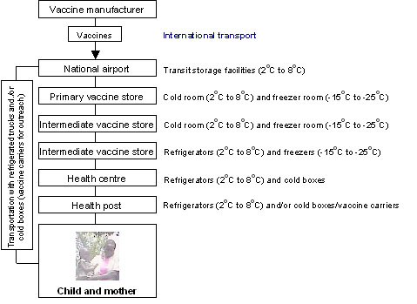

Slide 129
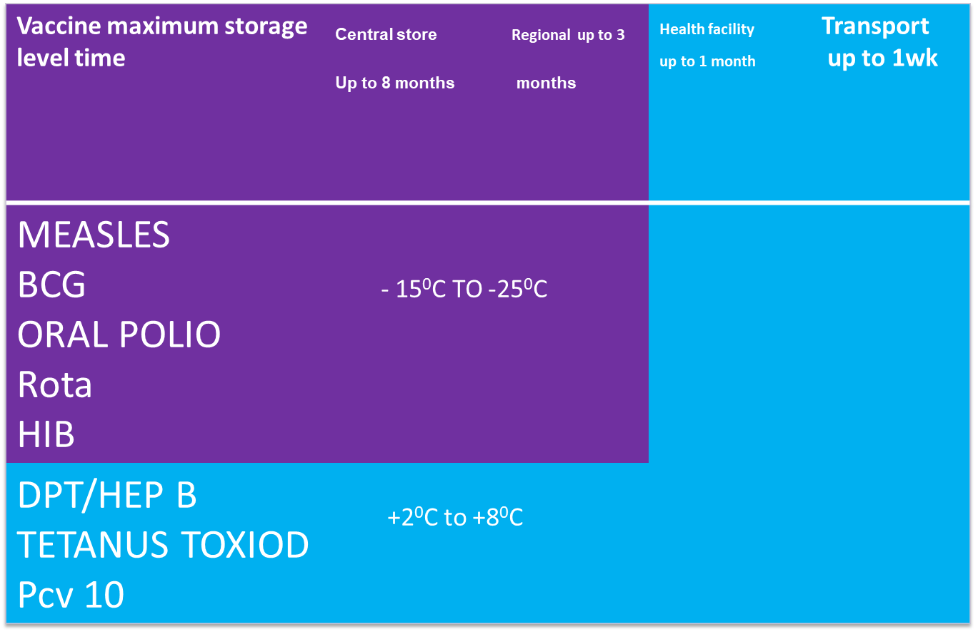
Storage Conditions in the Cold Chain System

Slide 130
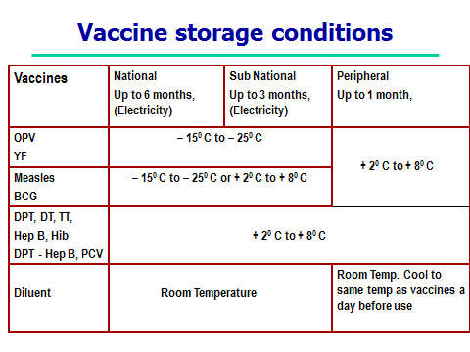

Slide 131
PROPER VACCINE MANAGEMENT CONDITION
You have to ensure that you handle the vaccines as per their different and specific characteristics.
Different vaccines are damaged by different conditions. For example, the polio vaccine is damaged by heat, measles and BCG should not be exposed to direct sunlight as it will damage them, while DPT, TT and HB can be damaged if frozen.

Slide 132
MONITORING OF THE COLD CHAIN SYSTEM
1. Temperature Recording
This is done twice daily, in the morning and in the afternoon. This is important since any failure in the functioning of the refrigerator will be noticed and immediate action taken.
This will save the loss of vaccines and prevent administration of vaccines that might have been exposed to high temperatures.
2. Cold Chain Monitor Cards (3m)
This is a special rectangular card with 4 oral windows with a “stabilizing strip” at the end.
The monitor has a heat sensitive indicator in the form of strip with 4 windows stuck to it.
This indicator operates at temperatures of 10⁰C and above 34⁰C. It detects cumulative heat exposure above the stated temperatures.

Slide 133
3. The Freeze Watch Indicator
The freeze watch indicator tells you when the vaccine has been exposed to freezing temperatures. It is useful in detecting vaccines such as DPT, TT, and HEP B that should not be frozen. If these vaccines have been frozen, they must not be used as they will have lost their potency.
4. Shake Test
This is a simple test that can be easily done at every stage of the cold chain and is used mostly in testing TT vaccines.
The sedimentation rate of a suspect vial is compared with a similar Tetanus Toxiod vial that is known to have been stored at the correct temperature.
Shake the two vials vigorously and inspect carefully in strong light.

Slide 134
5. Vaccine Vial Monitor (VVM)
A vaccine vial monitor (VVM) is a label made of heat – sensitive material that is placed on a vaccine vial to register cumulative heat exposure over time.
The combined effects of time and temperature cause the monitor to change colour gradually and irreversibly. VVM can be used on vaccine vials or the ampule.

Slide 135
Vaccine vial monitor showing
no heat exposure
√
The inner square is lighter than the outer ring
*USE the vaccine
√
As time passes, the inner square is still lighter than the outer ring *USE the vaccine
Discard point: The inner square matches the colour of the outer ring* DO NOT use the vaccine
x
x
Beyond the discard point. Inner square is darker than the outer ring * DO NOT use the vaccine

Slide 136
GENERAL RULES FOR STORING VACCINES IN A REFRIGERATOR
The coldest part of the refrigerator is the freezing compartment. It is used to store ice packs for freezing. Never store DPT/ HEP B, TT in the freezing compartment. They lose their potency at very low (freezing) temperatures.
The lower part of the refrigerator keeps the temperatures low but does not freeze the vaccines.
This is where you should keep both vaccines and diluents. Place the vaccines neatly in piles and leave enough space all around to allow for free air circulation.
Do not keep any vaccines on the door shelves or on the bottom shelf. Always use the oldest vaccine first. This is known as the “first in, first out” principle (FIFO).
The refrigerator must be level, at least 12 inches away from the wall, to allow free air circulation. Place the refrigerator away from direct sunlight.

Slide 137
DPT+ HepB+Hib and Tetanus Toxoid must never be frozen.
The Vaccine refrigerator temperature must be monitored twice every day (morning and evening) including on weekends and public holidays. The temperature reading should be recorded on the “Cold Chain Recording Chart” pasted on/near the refrigerator.
Vaccine taken out for outreach should be stored separately and used at the earliest opportunity.
Use of vaccines should be based on “First Expiry First Out” (FEFO) basis.
The empty vaccine vials must be destroyed immediately through burning or incineration where possible and appropriate forms filled immediately.
No vaccine vials with VVM that has reached discard point must be stored in the refrigerator.

Slide 138
Fraser D.M, copper M.A,et.al (2010):Myles Textbooks for Midwives African edition 2nd ed. Churchill Livingstone elsevier.London
www.e-medicine.com

Slide 139
ORGANIZING FOR IMMUNIZATION

Slide 140
OBJECTIVES
Arrange the waiting area
Organize the flow of patients/clients
Describe the process that takes place in the registration desk
List and explain the important tasks in MCH clinic
Organize for outreach and mobile health service.

Slide 141
ARRANGING THE SPACE FOR IMMUNIZATION
The space that you set up for immunizations should be:
• In a clean area not directly exposed to the sunlight, rain or drought
• Convenient for Health Worker who is preparing vaccines and immunizing
• Easily accessible to parent/guardian, but arranged in such away that it is not crowding around the immunization station
• Quiet enough for health workers to be able to explain what he or she is doing and give advice

Slide 142
ORGANIZE CLIENT FLOW
Immunization is one of the activities of the MCH clinic, so it should be integrated with the other services for good patient / guardian flow.
• For smooth floor two doors are ideal, one for entry and the other for the exit.
• Guide the parent / guardian into a single queue to enter the MCH area. Ensure a first-come first served system.
• As far as possible try to see one parent/ guardian at a time.
• Children who are very sick should he identified and attended to first.
• When the parents /guardians are through at MCH clinic thank him/ her for coming.

Slide 143
THE HEALTH FACILITY SHOULD HAVE
• Waiting area where parents and guardian can sit before being immunized as they receive health talks; as the talks will be better received if people are comfortably seated in the waiting bay.
• S pace and equipments for screening, registration, recording and immunizing.
• A table for vaccines and injection equipments.
• Two chairs/stools; one for the parent or guardian, one for the health worker.

Slide 144
Set up separate station for each of these services, which include.
• An area for health education
• Weighing babies and recording their growth
• Treatment
• Antenatal care
• If there are many parents/guardians waiting, sitting arrangements should in away that will ensure that parents/guardians maintain their place in the queue

Slide 145
REGISTRATION DESK
Children under five years old,
• Expectant women,
• Women for family planning services.
Greet the mothers in a friendly way. For new parent’s/guardian’s, give them appropriate cards and fill in personal information.
For re-attendants, tick in the appropriate registers

Slide 146
ACTIVITIES AT MCH/FP
Health Promotion:
topics
• Immunization
• Nutrition
• Family planning
• Ante-natal and post-natal care, mother’s T Immunizations
• Personal hygiene
• Cleanliness during food preparation and feeding times
• Proper environmental sanitation and other aspects concerning primary health care.
• Other relevant health topics e.g. PMTCT, VCT, Malaria control, ITNs etc.

Slide 147
WEIGHING
Weighing is done at every visit to monitor growth.
Requirements for weighing are:
• Weighing scales children;
• Weighing pants to put the child in;
• Table and chair;
• Weight scale for adults.
• Changing couch with mackintosh

Slide 148
HISTORY TAKING
• Ask if the child has any symptoms or if the mother has any other complaints.
• Ask her about the feeding the child.
• Examine the child physically.
• Check for BCG scar on the second visit after the injection and during her subsequent visits.
(If BCG scar is not visible three months after injection, repeat)

Slide 149
CHECK IMMUNUZATION STATUS
• Look at the child’s growth monitoring chart and interpret it
• Look at the child’s immunization status and vaccinate as appropriate
• Provide vitamin A supplementation as appropriate
• Ask the mother about her TT status and vaccinate as appropriate.

Slide 150
COUNSELLING
Discuss your findings on history taking, weighing and physical examination with the mother/ guardian and give appropriate advice.
(Give her compliments if the child is well looked after, if she is breast feeding, and if she has come on the right day and brought the child’s card).
Encourage her to continue infant feeding until the child is two years old.
Discuss possible immunization reactions.

Slide 151
Information to be recorded on each child’s health card
• The child’s particulars
• Health status, weight, Nutritional status
• Any treatment given
• Today’s immunization given
• The date for the next visit.

Slide 152
TREATMENT
• If the child is sick treat or refer as appropriate
• Confirm that parents/guardian have understood and encourage them to ask questions
• Give medicine as prescribed on the child’s card
• Instruct the mother clearly on how t administer drugs to the child.
• Register the treatment
• Give him/her time to ask questions if he/she has any

Slide 154
Arranging equipment and materials at the immunization station
You need a table to arrange the following:
• A vaccine carrier in which to place vaccines and keep them cold;
• Foam pads on top of the ice packs in the vaccine carrier to keep the vaccines cold.
• Adequate doses of vaccines.
• Auto-Disable syringes, Reconstitution syringes and needles.
• Dry cotton swabs in galipot or clean container.

Slide 155
Tally sheet and summary sheets.
• Child health cards and the TT cards.
• Permanent child registers and TT register.
• AEFI form.
• Near the table you should have Safety box for disposing used syringes and needles and refuse bins.
• A source of clean running water, soap, and disposable hand-drying materials.

Slide 156
POINT TO REMEMBER AT MCH/FP
Keep vaccines cold in a refrigerator and maintain +2oc to + 8oc . Keep the refrigerator closed all the time
• Take out from refrigerator all vaccines you will need for the session and put them in a vaccine carrier
• Ensure that the vaccine carriers are closed all the time.
• Change the ice pack before temperature reach +8o c
• Be friendly to both the parents/guardians and children
• Check all children to see what immunizations they have had and what they are due for

Slide 157
• If in doubt, ask the parents/guardians and confirm from the card
• Look for presence of BCG scar
• Give immunizations to all children, even the sick ones, unless the child needs hospitalisation
• Remind the clinical officer/nurse to send sick children to you for immunization
• Check the time interval between doses or immunization. For DPT-Hep B+Hib and OPV, Do not give second and third doses if the time interval is less than 4 weeks

Slide 158
REMEMBER: Do not give birth dose of oral Polio after two (2 weeks). To avoid giving different return dates for DPT-HepB+Hib, OPVandPCV.
At subsequent visits, start both antigens at six (6weeks) and repeat at interval of 4 weeks.
• On the other hand, even if the time limit is long past the minimum interval of 4 weeks give the next dose
• Do not start the schedule again. E.g. if you see a child who had first dose DPT-HepB+Hib,PCV and OPV six months ago, give second dose DPT-HepB+Hib ,PCV and OPV
• Mark on the tally sheet accordingly after each immunization you give. Remember to put down the date of immunization.

Slide 159
Make sure you explain clearly to the mother when to come for the next dose or the next immunization. Tell her she should come even if her child is sick
• Tell mothers about the reaction to expect from immunizations. Many mothers may have heardrumours. Reassure and tell them what to expect and how to respond
• Remember: Injectable immunizations need sterile procedures. Ensure your equipments i.e. AD syringes, reconstitution syringes and safety boxes are available and properly assembled.
• USE ONLY ONE STERILE SYRINGE AND NEEDLE FOR EACH INJECTION. After use, dispose it into safety box immediately at the point of use.
• After the clinic session, take all tally sheets and fill in the monthly summary sheet. Clean and tidy up the clinic before you go off duty, ready for the next day.

Slide 160
OUTREACH/ MOBILE SERVICES

Slide 161
Organization:
An outreach clinic is where you take MCH services and curative services from a healt facility to the community within the catchment area and return back to the health facility the same day.
A mobile clinic is taking MCH services to a community, lasting for more than one day without returning to the health facility.

Slide 162
ACTIVITIES INVOLVED IN OUTREACH/MOBOLE CLINIC
Determine the need for outreach clinics in terms of access and utilization
• Determining the size of target population and the number of children and women that you
can immunize in one session
• For the best results, consult with community leaders and clients about dates and time, as they will help mobilize the community.
• Discuss your plans for mobile/outreach clinics with the members of the SCHMT

Slide 163
• Make sure you tell mothers which days to expect you, and the time session will start. Be reliable and punctual.
• Make sure that you keep vaccines cold (+2o to +8o degrees Centigrade).
• When you arrive, arrange your mobile or outreach clinics similar to that of your static health facility
• Once the immunization session starts, open your cold box or vaccine carrier once, take the vaccines you need according to the number of mothers and children expected and put them on holes in the sponge which is replaced on vaccine carrier during the session, replace ice packs as soon as the ice has melted. Carry a spare vaccine carrier/cold box with icepacks for replacement.
• Complete the immunization tally sheet and remember to transfer the data and the name of the outreach clinic to the immunization summary sheet

Slide 164
REACHING THE TARGET POPULATION USING THE RED APPROACH (REACH EVERY CHILD)

Slide 165
TARGET POPULATION GOT REC APPROACH
Unvaccinated children
Unvaccinated mothers

Slide 166
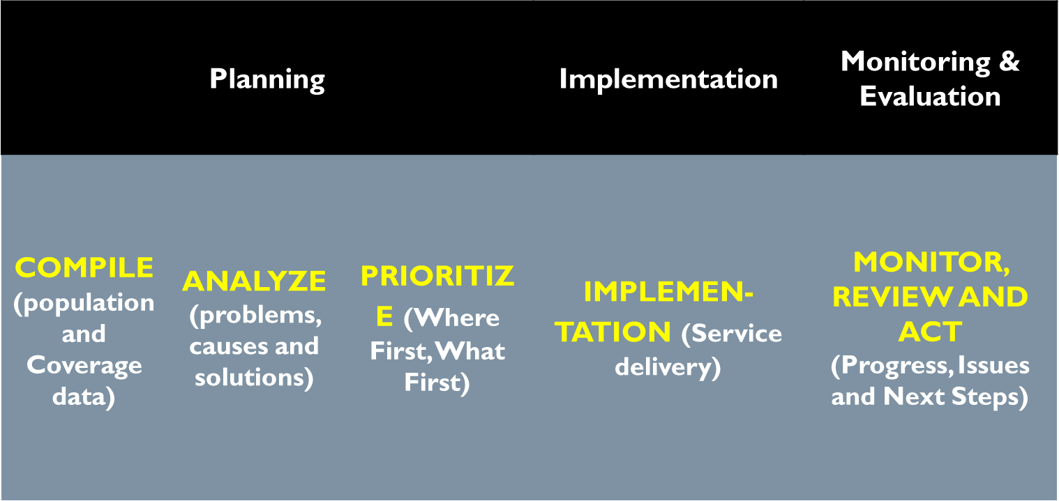
RED APPROACH IMPLEMENTATION FRAME WORK

Slide 167
COMPILE POPULATION & COVERAGE FOR SUB-COUNTY LEVEL
List all the facilities
Get the estimate target population of each facility
Obtain the absolute figure of children vaccinated
Calculate immunization coverage for each health facility

Slide 168
Draw a simple District map showing the following important information:
Location of each Health Facility;
Total population and target population of each Health Facility;
all known high-risk or priority areas;
Important roads and geographical landmarks (rivers, streams, mountains);

Slide 169
List all the villages
Get the estimate target population of each village
Obtain the absolute figure of children vaccinated
Calculate immunization coverage for each catchment area

Slide 170
Draw a simple map of the HF catchment area. Mark the following important information on the map:
Location of each village;
the total population and target population of each village;
distances between village and health facility
transport frequently used by HF to reach village and time (if known)
all known high-risk or priority areas;
roads and geographical landmarks (rivers, streams, mountains);

Slide 171
ANALYSIS OF THE PROBLEM
Calculate Un-vaccinated children
Calculate Drop-out rates
Identify type of immunization performance problem

Slide 172
Calculation of coverage and un-vaccinated children
Children vaccinated with Measles Antigen
Coverage of Measles / FIC
NB/Low coverage of Measles means there is problem of immunization services

Slide 173
Categorization of coverage
Measles = or over 90%
Good coverage
Coverage
Measles below 90%
Poor coverage

Slide 174
ACCESS
Possibility of the person reaching the intended place easily and getting service
Vaccination access: determined by 1st dose of Penta
Are they coming? Yes they will be vaccinated – access good
If not than they can not be vaccinated.
Why are they not coming?? Not accessible
Identify the reasons of not accessible

Slide 175
UTILIZATION
Continuation of using the services
Vaccination utilization: determined by Measles coverage
Do they continue to use the services? Yes, drop out is low.
If not than high drop out. They can not finish required doses.
Why?? Not utilizing the services
Identify the reasons of not utilizing services

Slide 176
CALCULATION
Children vaccinated with 1st dose of Penta
Children vaccinated with Measles
Penta 1 – Measles = Children who have dropped out from the service
Drop out rate: multiply 100 (standardization)
Penta 1 – Measles x 100
Penta 1

Slide 177
Categorization of utilization
Drop out rate below 10%
Good utilization
Utilization
Drop out rate = or above 10%
Poor utilization

Slide 178
Categorization of access and utilization
Interpretation
Category 1
Good access
Good utilizat.
Category 2
Good access
Poor utilizat.
Category 3
Poor access
Good utilizat.
Category 4
Poor access
Poor utilizat.

Slide 179
RED Activities at District level
Planning
Compile, Analyze and Prioritize
District
Microplaning
County (district) Level
Health Facility level
Health Facility Micro planning:
Compile, Analyze Prioritize and Plan

Slide 180
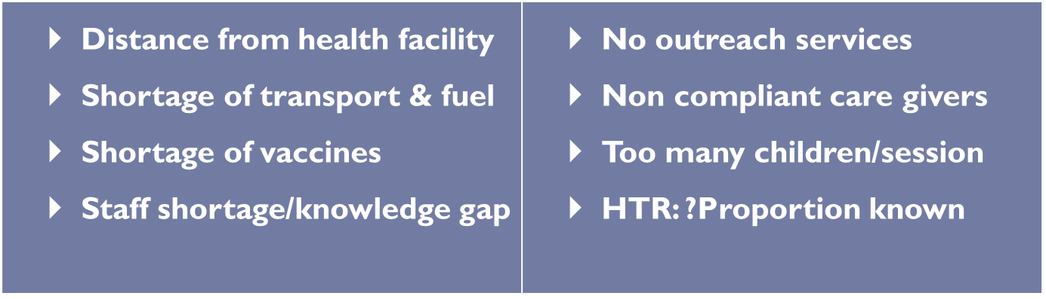
Reaching the Target Population
Step 3: Develop individual microplans with
health facilities
Discuss with the facilities staff: Why are they not reached?
Could it be:

Slide 181
Where to focus
Select the facilities which are contributing a big number of vaccinated children
Avoid to over stretch the resources
To be realistic - 10 facilities
Experience shows 10 facilities contribute more than 50% of unvaccinated children

Slide 182
Way forward
To build the capacity of the district to able to do this analysis
Analysis need to be done regularly
This process can be done frequently as the situation allows
Prioritize the health facilities to focus

Slide 183
WHY ARE THEY NOT REACHED
Discuss with the facilities staff: Why are they not reached
Example:
Distance from the health facility
Shortage of vaccines
Shortage of staff to vaccinate
No outreach services
Non compliance
Too many children per session
Hard to reach

Slide 184
WAY FORWARD
All unvaccinated children must be reached
Analysis of performance needs to be done regularly
Build capacity of the district to be able to do this analysis
Determine health facilities with large number of unvaccinated children and Prioritize the health facilities to focus
Implement service delivery strategies that are appropriate to the needs of the populations; Be innovative.

Slide 185

YES WE HAVE

